Slide 1
Workshop 2.2: Research Hypotheses, Indicators and Data Collection
Adrian Matthew G. Glova
Assistant Professor
UP School of Statistics

Slide 2
Objectives
Identify the unit of assignment, treatment, and analysis
Identify the evaluation problem
Formulate the evaluation questions and research hypotheses
Theory of Change provides context
Select outcome and implementation indicators
Indicators need to be SMART
Set outcome indicators by length of time (short, mid, long-term)
Identify data sources and data collection instruments

Slide 3
“Units” in Impact Evaluation

Slide 4
Identifying the “Units” of Evaluation
Units of evaluation should be based on the program design
Program | Unit of Assignment | Unit of Treatment | Unit of Analysis
New Mathematics Curriculum | Provinces | Schools | Teachers and children
The revamped curriculum is to be piloted to Junior HS students given lagging mathematical competencies | Treatment is piloted to the 20% poorest villages identified by the implementing agency | Treatment is delivered to schools as learning materials and training are provided there | Treatment is supposed to improve the education and social mobility outcomes of children; teachers should have an easier administrative load

Slide 5
Identifying the “Units” of Evaluation
For the program you intend to evaluate, please identify the unit of assignment, unit of treatment, and unit of analysis (15 mins)
This should be based on the program design!!
Program | Unit of Assignment | Unit of Treatment | Unit of Analysis
Treatment to be evaluated | Fill in | Fill in | Fill in
Description of the intervention | Remarks from program design | Remarks from program design | Remarks from program design

Slide 6
Next, we identify the evaluation problem

Slide 7
Identifying the Evaluation Problem
Sample evaluation problem:
What would have been the standardized test scores of students who used the new Math curriculum had they not received the treatment (i.e. taking deworming pills)?
What are possible reasons why it’s difficult to construct a counterfactual for your treatment group?
The counterfactual cannot be observed
Children who are enrolled in the new Math curriculum might be systematically different from those who aren’t
Example: Family income, parents’ education and location might matter
The presence of other government interventions in the area (e.g. establishment of another school) may mediate impact

Slide 8
Identifying the Evaluation Problem
For the program you intend to evaluate, please identify the evaluation problem. Likewise, list down possible reasons (3 to 5) on why it is difficult to construct a counterfactual estimate (15 mins)

Slide 9
Now, we formulate the evaluation question(s)

Slide 10
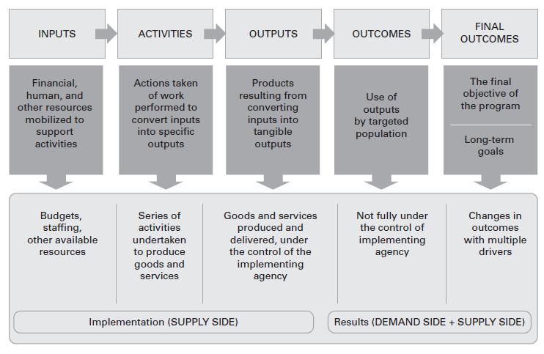
Formulating the Evaluation Question(s)
The evaluation question is anchored on the results chain of the Theory of Change. You are given 15 minutes to review and revise this

Slide 11
Formulating the Evaluation Question(s)
What is the core evaluation question? This should relate the program/intervention being evaluated with the outcomes of interest
First attempt: What is the impact of the new Math curriculum to students’ education outcomes? (still too broad)
Second attempt: Did the new Math curriculum increase standardized test scores by 5 ppts for student-beneficiaries? (direction of effect specified; outcome narrowed down and targeted)
Note that this evaluation question is of the first kind (first generation)

Slide 12
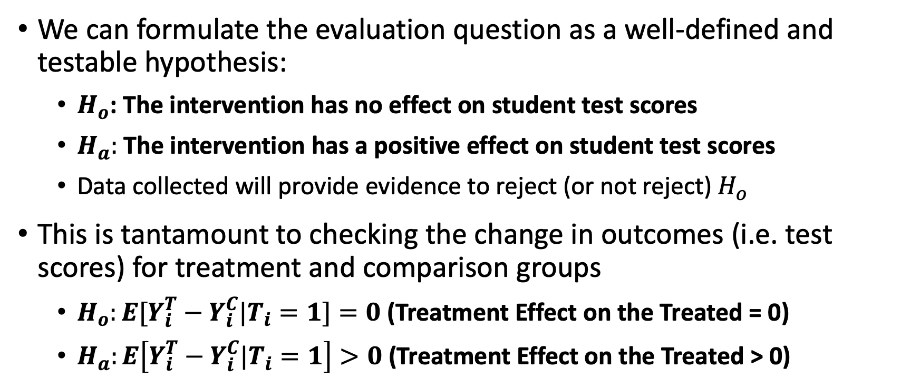
Research and Statistical Hypotheses
We can formulate the evaluation question as a well-defined and testable hypothesis:
$H_{o}$: The intervention has no effect on student test scores
$H_{a}:$ The intervention has a positive effect on student test scores
Data collected will provide evidence to reject (or not reject) $H_{o}$
This is tantamount to checking the change in outcomes (i.e. test scores) for treatment and comparison groups
$H_{o}:E[Y_{i}^{T}−Y_{i}^{C}|T_{i}=1]=0$ (Treatment Effect on the Treated = 0)
$H_{a}:E\left[Y_{i}^{T}−Y_{i}^{C}|T_{i}=1\right]>0$ (Treatment Effect on the Treated > 0)

Slide 13
Evaluation Question(s) and Hypotheses
For the program you intend to evaluate, please formulate the evaluation question(s) and research hypotheses. If you have multiple outcomes of interest, specify it for each (15 mins)

Slide 14
We proceed with the selection of performance indicators

Slide 15
Selecting Performance Indicators
The outcome indicators will be the criteria for success of a program
Performance indicators, particularly outcome indicators, should be SMART:
Specific – the information should be well specified and is not vague
Measurable – the information can be readily obtained
Attributable – the indicator is linked to the implementation of the program
Realistic – the information can be obtained in a timely manner, at a reasonable frequency and at a reasonable cost
Targeted – the indicator applies to the targeted population

Slide 16
Selecting Performance Indicators
Sample outcome indicators:
Short-term: Standardized test scores, teacher adoption of the new Math curriculum
Medium-term: High school completion rate
Long-term: Income and college completion rate
The same should be done for relevant implementation indicators so our impact evaluation will not be a “blackbox”

Slide 17
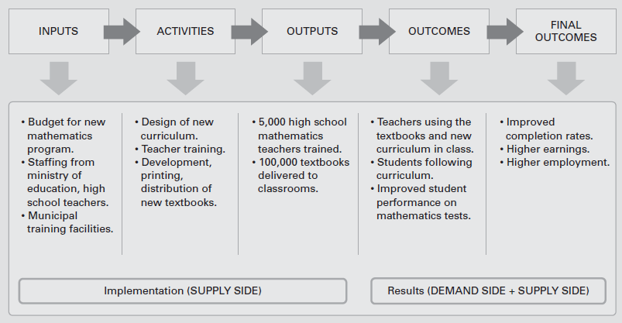
Selecting Performance Indicators
Source: Gertler et al. (2016).

Slide 18
Selecting Performance Indicators
Deliberate on the appropriate outcome indicators based on your results chain. Make sure that the indicators are SMART. You may divide them by length of time. (30 mins)
Based on the results chain, identify relevant implementation indicators (i.e. at the level of Inputs, Activities, and Outputs). (30 mins)

Slide 19
We now identify data sources

Slide 20
Data Collection Plan
For the identified indicators, state the potential data source. If possible, include the party in charge of data collection, the data collection instrument, and data frequency (30 mins)
If you intend to conduct primary data collection, specify your sampling design and survey operations strategy:
Sampling technique
Sample size determination
Survey operations workplan (i.e. crafting and piloting of questionnaire, recruitment and training of enumerators, securing approvals, survey administration, data entry and validation)

Slide 21
Metadata: Data on our Data
Indicator | Unit of Observation | Results Chain Level/ Nature of Variable | Data Source | Data Collection | Data Collection Instrument | Frequency
Program Disbursements (mPhP) | Program | Inputs | Administrative Data | Department of Budget and Management; Department of Education | Financial Information management system | Monthly
Standardized Test Scores | Student | Short-Term Outcomes | Administrative Data | Department of Education | Learner Information system | Real-time
Annual average income | Household | Long-Term Outcomes | Survey (say FIES) | Philippine Statistics Authority | Household survey questionnaire | Every 3 Years
Sex of Household Head | Household | Observable Covariates (X’s) | Survey (say FIES) | Philippine Statistics Authority | Household survey questionnaire | Every 3 Years

Slide 22
We now present our outputs

Slide 23
Flow of Presentation
Unit of assignment, treatment, and analysis
What is the evaluation problem?
Core evaluation questions and hypotheses
Outcome and implementation indicators (along the results chain)
Data collection plan:
Data sources
Data collection instruments
Sampling design and survey operations

